Slide 1
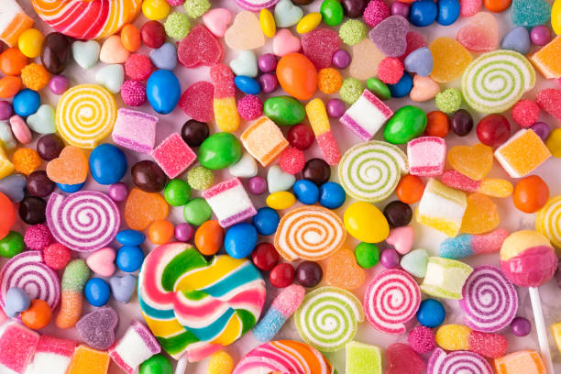
US CANDY DISTRIBUTION ANALYSIS

Slide 2
Project Overview
Power BI Dashboard
Created an interactive Power BI dashboard with various charts, graphs, and slicers to visualize key metrics and trends, facilitating better decision-making.

Slide 3
Division
V
Factory
V
Product Name
V
Power BI Desktop
2021 | 2022 | 2023 | 2024
All
All
All
V
V
V
Total Sales CY
$47K
Total Cost
$92K
Total Profit
38K
Quantity Sold
$45,959
66%
Gross Profit Margin…
Target: 45000 (+2.13%)
Total Sales CY vs LY
Sales by Division
Previous Year Sales (ADD DATE)
Total Sales CY
Sum of Sales
Sum of Target
LY vs CY
Chocolate
Other Sugar
$0K $20K
Sum of Sales by City
December
November September October
May August
July April March June January February
Division
Nove…
Septe… Decem… October
June March May August
July April January February
$40K
$60K $80K
Sum of Sales and Sum of Target
$100K
$120K
$140K
Month
New York City Los Angeles Philadelphia San Francisco
Month
City
$0K
$5K
$10K
City
Sum of Sales
Sum of Gross Profit
V
Sum of Units
Average of Profit M
New York City | $12,514.90 | $8,240.51 | 3417 | 32.46%
Los Angeles | $10,408.75 | $6,898.61 | 2879 | 34.15%
Philadelphia | $7,415.52 | $4,813.82 | 1981 | 32.51%
San Francisco | $7,018.61 | $4,650.77 | 1935 | 34.34%
Seattle | $5,893.39 | $3,880.68 | 1590 | 32.96%
$0K $20K
Previous Year Sales (ADD DAT…
0K
5K
Diff.Total Sales LY vs CY

Slide 4
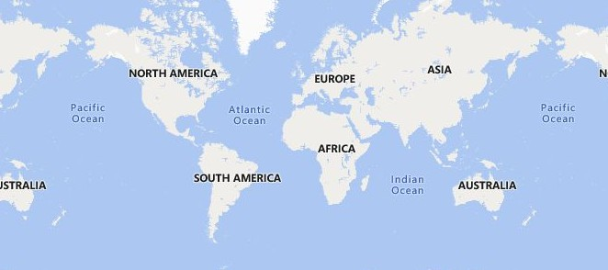


Division
Power BI Desktop
V
Factory
V
Product Name
V
2021
2022
2023
2024
All
All
All
V
V
V
Total Sales CY
$45,959
10K
Total Orders
$47K
Total Cost
38K
Quantity Sold
66%
Gross Profit Margin %
Target: 45000 (+2.13%)
Top 5 Cities by Sales and Profit Margin
Top 3 Products by Sales and Profit Margin
Yonkers
$269.11
$167
Wonka Bar - Triple Da…
$28,088 | $18,350
$27,227 | $18,908
$598 |  | $311
Yuma | $78.59 |  | $54
York | $70.2 |  | $46
Product Name
City
Wonka Bar -Scrumdid…
Woonsocket $53.53 $37
Yucaipa
Wonka Gum
Sum of Sales and Sum of Gross Profit
Sum of Sales and Sum of Gross Profit
Factory Name  | Sum of ProductOrders | Sum of ProductProfit | Sum of ProductQTY | Sum of Pr
Lot's O' Nuts | 4669 | $51,802 | 21019 | $74
Secret Factory | 209 | $4,205 | 870 | $8,
Sugar Shack | 33 | $121 | 107 | $2
The Other Factory | 98 | $152 | 388 | $1,
Total | 8389 | $91,508 | 37873 | $138
Division
V
Sum of Sales
Sum of Gross Profit Sum of Units Average of Profit Margin
 Sugar | $427 | $285 | 137 | 32.82
 Other | $9,383 | $4,193 | 1228 | 20.41
 Chocolate | $129,020 | $87,030 | 36508 | 33.71
Total | $138,830 | $91,508 | 37873 | 33.30
©© 22002255 TToommTToomm,, ©© 22002255 MMiiccrroossoofftt CCoorrppoorraattiioonn,, ©© OOppeennSSttrreeeettMMaapp

Slide 5
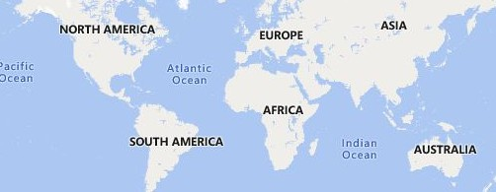


Division
Power BI Desktop
V
Factory
V
Product Name
V
2021
2022
2023
2024
All
All
All
V
V
V
Total Sales CY
9994
Total Orders
5009
No. of Customers
2207
Repeated Customers
44%
Customers Retention R…
$45,959

Target: 45000 (+2.13%)
Customers by Market
Customer Distribution Map
Sales by Region
$45.45K (32.74%)
1.62K (16.21%)
3.2K (32.05%)
$22.25K (16.02%)
Region
Pacific
Atlantic Interior Gulf
Region
Pacific
Atlantic Interior Gulf
2.32K (23.24%)
$31.9K (22.98%)
2.85K (28.5%)
$39.23K
(28.26%)
©© 22002255 TToommTToomm,, ©© 22002255 MMiiccrroossoofftt CCoorrppoorraattiioonn,, ©© OOppeennSSttrreeeettMMaapp
Customer ID Sum of Total Orders Sum of Total Quantity Ordered Sum of Total Sales Sum of Gross Profit Gr
V
100111 | 14 | 52 | $182 | $126
117457 | 9 | 46 | $168 | $112
122336 | 4 | 39 | $352 | $193
164756 | 8 | 35 | $304 | $166
163790 | 6 | 31 | $209 | $114
163328 | 6 | 23 | $198 | $109
165344 | 3 | 21 | $189 | $103
124163 | 4 | 19 | $247 | $128
164770 | 2 | 19 | $232 | $123
138247 | 6 | 17 | $176 | $95
164147 | 3 | 16 | $205 | $107
140326 | 3 | 15 | $202 | $105
Factory Name | Product Name | ProductSales | ProductProfi
Lot's O' Nuts | Wonka Bar - Fudge Mallows | $24,451 | $16,301
Lot's O' Nuts | Wonka Bar - Nutty Crunch Surprise | $23,257 | $16,593
Lot's O' Nuts | Wonka Bar -Scrumdiddlyumptious | $27,227 | $18,908
Secret Factory | Everlasting Gobstopper | $130 | $104
Secret Factory | Lickable Wallpaper | $7,580 | $3,790
Secret Factory | Wonka Gum | $598 | $311
Sugar Shack | Fizzy Lifting Drinks | $79 | $47
Sugar Shack | Fun Dip | $12 | $5
Sugar Shack | Laffy Taffy | $54 | $33
Sugar Shack | Nerds | $15 | $7
Sugar Shack | SweeTARTS | $62 | $29

Slide 6
Conclusion : Key Insights & Strategic Focus
Total Sales and Targets: Analyzed total sales against targets, identifying areas of success and potential improvement. In 2024, total sales reached $46,959, successfully meeting the set target! This demonstrates a strong performance overall. 📌 Customer Segmentation: Identified key customers based on order volume and sales value. We discovered that a small number of customers (approximately 10%) account for a significant portion (around 95%) of total sales. This highlights the importance of maintaining strong relationships with these key accounts. 📌 Geographic Distribution: Mapped customer locations and sales by region. ️ The analysis revealed that the Pacific region is a key market, generating the highest sales volume, while the Gulf region presents an opportunity for growth, currently showing the lowest sales figures. This suggests targeted regional strategies are needed. 📌 Product Performance: Analyzed product sales to identify top performers and underperforming products. "Wonka Bar—Triple Dazzle Caramel" emerged as the top seller, with sales of $28,087, significantly outperforming other products. This indicates strong market demand for this product. .

Slide 7
Based on these insights, I recommend: 💡 Strategic Account Management: Focus on nurturing relationships with the key customers who drive a significant portion of revenue. Implementing a dedicated account management program could further strengthen these partnerships and potentially increase sales. 💡 Targeted Marketing Campaigns in the Gulf Region: Develop and implement targeted marketing campaigns in the Gulf region to increase brand awareness and drive sales growth. This could involve local advertising, promotional events, or partnerships with local retailers. 💡 Product Portfolio Optimization: While "Wonka Bar - Scrumdiddlyumptious" is a clear winner, further analysis should be conducted on underperforming products to understand the reasons for their lower sales. This could lead to product improvements, repositioning, or potentially discontinuing less profitable items to optimize the product portfolio. ️ 💡 Supply Chain Optimization for Top Seller: Given the high demand for "Wonka Bar - Scrumdiddlyumptious," ensure the supply chain is optimized to meet this demand and prevent stockouts. This might involve increasing production capacity or streamlining distribution processes.
.

